Slide 1
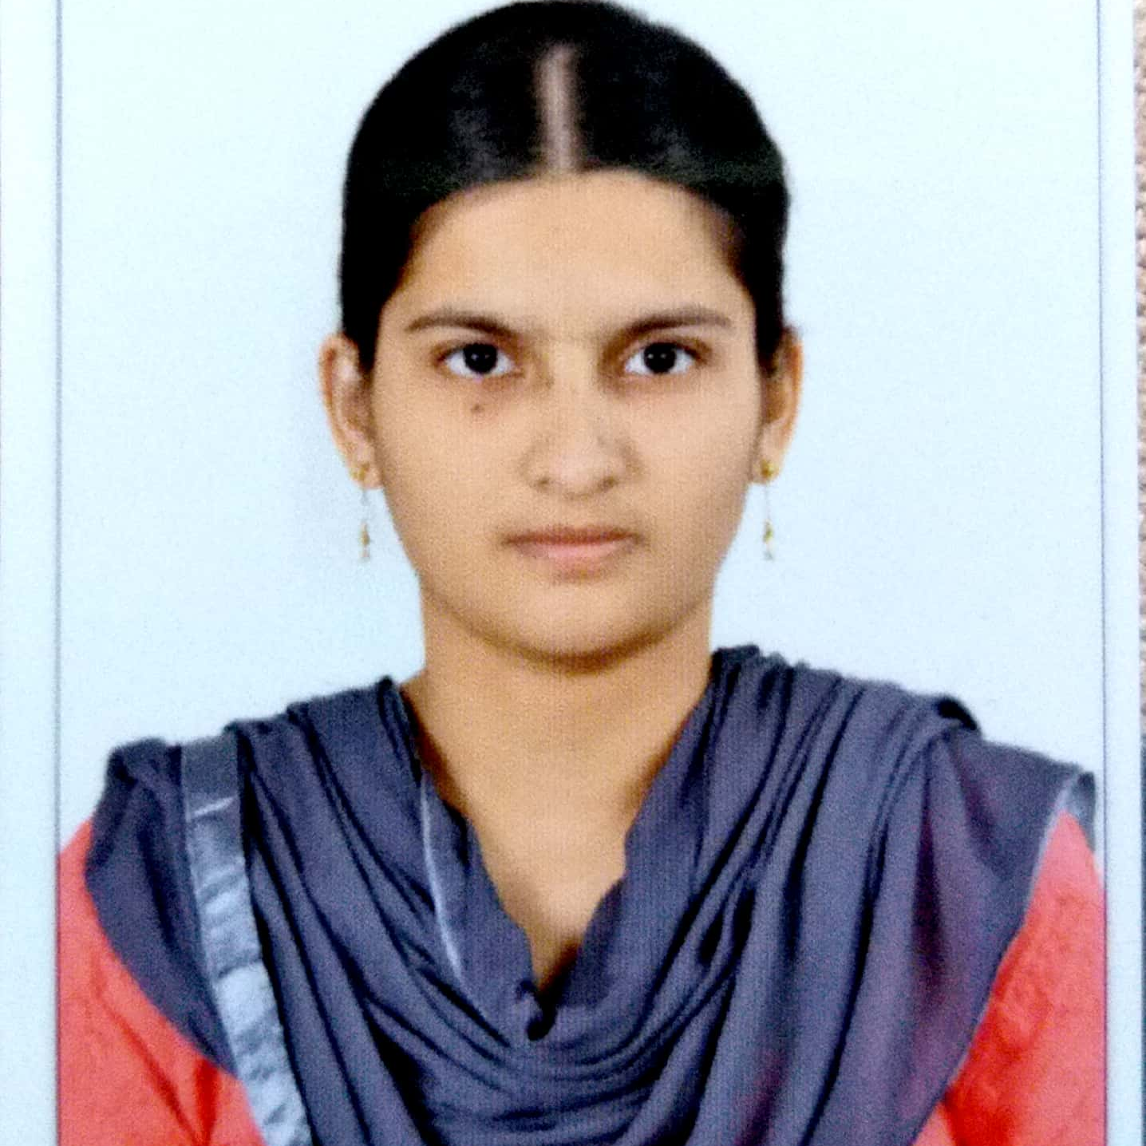



Ayesha Fathima Mohammed
Bachelor of Technology
Computer Science : 2016 - 2020
Skills Java 11
Spring Boot
Spring MVC
Spring Security
MERN Stack
NodeJS
MongoDB
Database
SQL database – MySQL
No SQL database – MongoDB
Web Technologies
HTML5
CSS3
Javascript
AddOns
Github
Maven
Postman
Additional Details
Leadership
Quick Learner
Team management
Analyst/Software Engineer
Bangalore
ayesha-fathima.mohammed@capgemini.com
+91-9494478786
A4
Software Engineer who is Strong in design and integration with intuitive problem-solving skills. Passionate about implementing and launching new projects.
Ready to learn new technologies and implement them to further improve my knowledge.
Eager to work in a team of dedicated people and serve a key role in the enhancement and development of the project.
Has working knowledge on Angular and Java Microservice Development using Spring framework on an intermediate level.
Flight Booking System
Completed end to end case study of Flight Booking System along with JWT authentication, Swagger, Angular Material-UI and Bootstrap used for user interface.
HTML CSS JAVASCRIPT for web developers on DEGREED
Completed this course as part of my training and designed responsive Restaurant website using HTML5 ,CSS3 and Angular
Check out my work on GitHub & Video Profile

